Slide 1
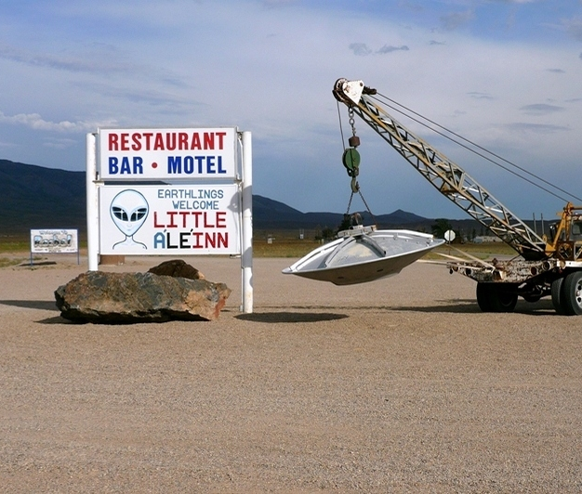
AREA 51 – The Hidden Secret

Slide 2
AREA 51 – Briefing “Uncover”
You are about to embark on a joint training mission in Nevada.
Code Name: “Uncover”
Priority: High
Ground forces are moving towards your area. Our Command Center is in contact with our Forward Air Controllers, which are monitoring the enemy positions.
Engage the A2G SEAD, BAI and CAS tasks ordered by mission command and eliminate the enemy. Good Luck!

Slide 3
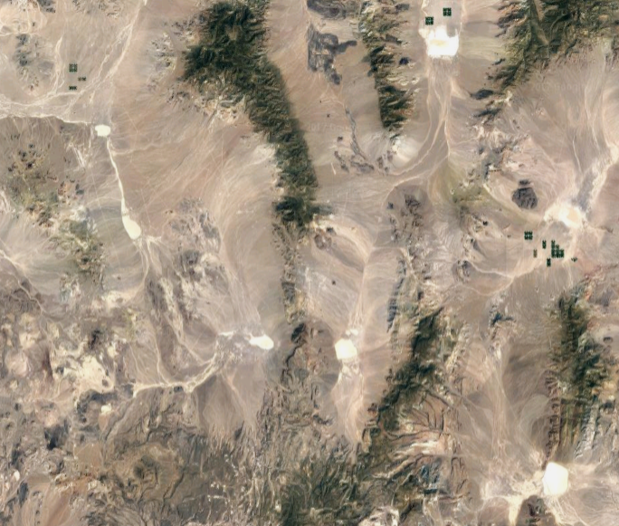
AREA 51 – Satelite Image
Tonapa
Rachel
Groom Lake

Slide 4
AREA 51 – Satelite Image
Air Defenses
Air Defenses

Slide 5
AREA 51 – Satelite Image
Locations Enemy Ground Forces

Slide 6
AREA 51 – Satelite Image
A2A Attack

Slide 7
AREA 51 – Satelite Image
A2G Attack Locations

Slide 8

A design using MOOSE

